Slide 1
2017 HazCom Refresher
City Of Anderson SC

Slide 2
OSHA’s Revised HAZCOM Standard (3/26/2012)
Safety Policies & Programs
GHS
The
Globally Harmonized System
Of Classification and Labeling of Chemicals
Your Right to Know and Understand
Hazardous Chemicals Used in the Workplace

Slide 3
Evolution of the OSHA HAZCOM Standard
1983 – OSHA First Implements its Hazardous Communications Standard for Manufacturing ONLY
1987 – OSHA Expands to Include All Industries
1994 – Changes for Multi-Employer Worksites
2012 – OSHA adopts the International Approach Called the Globally Harmonized System (GHS) of Classification and Labeling of Chemicals (Rev 3)
Rev 4

Slide 4
OSHA’s Revised HAZCOM standard
Effective Completion Date | Requirement(s) | Who
March 26, 2012 | Final Rule Published | OSHA
December 1, 2013 | Train Employees | Employers
Transition Period | Comply with Old and Begin Compliance with New HCS Standard | All chemical manufacturers, importers, distributors and employers
June 1, 2015 | Compliance) | All chemical manufacturers, importers, distributors and employers
December 1, 2015 | Distributors may ship products labeled under the old system until this date | Distributors
June 1, 2016 | Update workplace labeling and HAZCOM program | Employers

Slide 5
Changes to the OSHA HAZCOM Standard
Old OSHA HAZCOM Standard:
Material Safety Data Sheets (MSDS) Are Performance Based -Required Content But No Set Format
Information Was Different For Each Company
Workers Had Difficulty Understanding Information
The Length and Complexity Made It Difficult to Locate Important Safety Information
Chemical Product Labels Had Minimal Information

Slide 6
Changes to the OSHA HAZCOM Standard
NEW OSHA HAZCOM Standard with GHS:
Prescribes a 16-Part Safety Data Sheet (SDS) Format and Contents
Chemical Product Labels Require New Prescribed Information Linked to New Criteria for Health and Physical Hazard Classifications and Categories
This Standard Update Gives Workers Access to Labels and Safety Data Sheets with Information that is Easier to Find and Understand as well as the Right to Know

Slide 7
Changes to the OSHA HAZCOM Standard
Material Safety Data Sheets
The Primary Source for
Chemical Product Hazard Information
Are Now Called
Safety Data Sheets
Must be in English
Should be Available in Languages of ESOL Workers

Slide 8
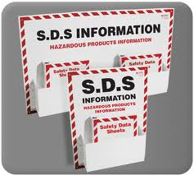
Got a Question
Don’t Know If a New Product Can Cause Illness
How Do You Use It and Protect Yourself
What Do You Do In Case of a Spill
SDS Safety
Data
READ the SDS Before You Use the Product
Lists Routes of Entry, Symptoms of & Care if Exposed
Recommends PPE, Handling, Storage & Cleanup
The Vendor Should Provide You a SDS With Purchase
If Not, Ask For SDS
If Product Is Not Listed in BCB’s On-Line Inventory,
the Supervisor Must Send SDS to BCB Safety

Slide 9
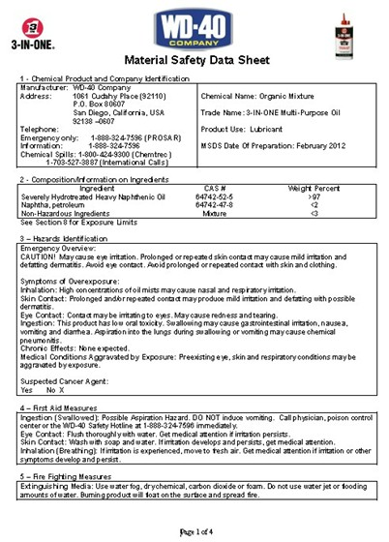
Changes to the OSHA HAZCOM Standard
Safety Data Sheets – 16 Part Format:
Section 1: Identification – Includes the
Product Identifier
Manufacturer ‘s or Distributor’s
Name
Address
Phone Number
Emergency Phone Number
Recommended Use
Restrictions on Use

Slide 10
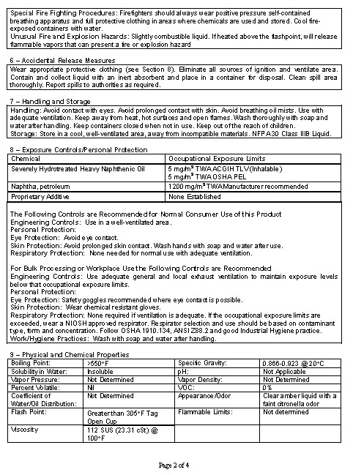
Changes to the OSHA HAZCOM Standard
Safety Data Sheets – 16 Part Format:
Section 2: Hazard(s)Identification
All Hazards Regarding the Chemical
Required Label Elements
Section 3: Composition / Ingredients
Information on Chemical Ingredients
Trade Secret Claims

Slide 11
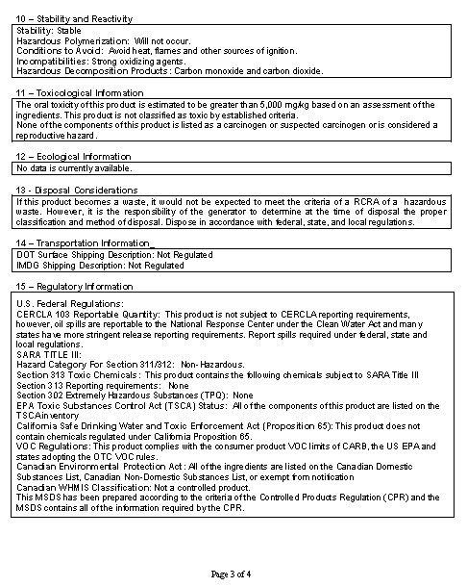
Changes to the OSHA HAZCOM Standard
Safety Data Sheets – 16 Part Format:
Section 4: 1st Aid Measures
Important Symptoms and Effects
Acute or Delayed
Required Treatment
Section 5: Fire-Fighting Measures
Lists Suitable Extinguishing Techniques and Equipment
Chemical Hazards From Fire

Slide 12
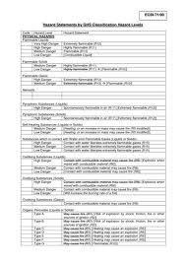
Changes to the OSHA HAZCOM Standard
Safety Data Sheets – 16 Part Format:
Section 6: Accidental Release Measures
Emergency Procedures
Protective Equipment
Proper Containment and Cleanup
Section 7: Handling and Storage
Precautions for Safe Handling and Incompatibilities

Slide 13
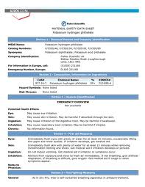
Changes to the OSHA HAZCOM Standard
Safety Data Sheets – 16 Part Format:
Section 8: Exposure Controls / Personal Protection
Permissible Exposure Limits
Threshold Limit Values
Engineering Controls
Personal Protective Equipment
Section 9: Physical & Chemical Properties
Chemical’s Characteristics

Slide 14
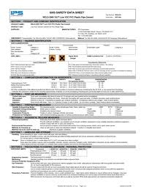
Changes to the OSHA HAZCOM Standard
Safety Data Sheets – 16 Part Format:
Section 10: Stability & Reactivity
Lists Possibility of Hazardous Reactions
Section 11: Toxicological Information
Routes of Exposure
Related Symptoms
Acute and Chronic Effects
Numerical Measures of Toxicity

Slide 15
Changes to the OSHA HAZCOM Standard
Safety Data Sheets – 16 Part Format:
Section 12: Ecological Information
Section 13: Disposal Considerations
Section 14: Transport Considerations
Section 15: Regulatory Considerations
Section 16: Other Information
Date of Preparation or Last Revision
Enforced by Other Agencies (Not OSHA)

Slide 16
Changes to the OSHA HAZCOM Standard
SAMPLE
LABELS – as of Dec 1, 2015
will be required to have:
Product Identifier
Signal Word
Hazard Statement
Pictograms
Precautionary Statement
Supplier Identification
ToxiFlam (Contains: X Y Z)
Danger!
Toxic If Swallowed
Flammable Liquid and Vapor
Do not eat, drink or use tobacco when using this product. Wash hands thoroughly after handling. Keep container tightly closed. Keep away from heat/sparks/open flame – No Smoking. Wear protective gloves and eye/face protection. Ground container and receiving equipment. Use explosion-proof electrical equipment. Take precautionary measures against static discharge. Use only non-sparking tools. Store in cool/well ventilated place.
IF SWALLOWED: Immediately call a POISON CONTROL CENTER or doctor/physician. Rinse mouth.
In case of fire, use water fog, dry chemical, CO₂ or “alcohol” foam.
See Safety Data Sheet for further details regarding this product.
MyCompany, MyStreet, MyTown NJ 00000
Tel: 444 999 9999

Slide 17
Changes to the OSHA HAZCOM Standard
SAMPLE
LABEL:
Product Identifier - the
Chemical Name
Product Name or
Other Unique Identifier
Used On Both
the Label
and the
Safety Data Sheet
ToxiFlam (Contains: X Y Z)
Danger!
Toxic If Swallowed
Flammable Liquid and Vapor
Do not eat, drink or use tobacco when using this product. Wash hands thoroughly after handling. Keep container tightly closed. Keep away from heat/sparks/open flame – No Smoking. Wear protective gloves and eye/face protection. Ground container and receiving equipment. Use explosion-proof electrical equipment. Take precautionary measures against static discharge. Use only non-sparking tools. Store in cool/well ventilated place.
IF SWALLOWED: Immediately call a POISON CONTROL CENTER or doctor/physician. Rinse mouth.
In case of fire, use water fog, dry chemical, CO₂ or “alcohol” foam.
See Safety Data Sheet for further details regarding this product.
MyCompany, MyStreet, MyTown NJ 00000
Tel: 444 999 9999

Slide 18
Changes to the OSHA HAZCOM Standard
SAMPLE
LABEL:
Signal Word
Indicates the Severity of the Chemical Hazard
DANGER – Most Severe
Warning – Less Severe
ToxiFlam (Contains: X Y Z)
Danger!
Toxic If Swallowed
Flammable Liquid and Vapor
Do not eat, drink or use tobacco when using this product. Wash hands thoroughly after handling. Keep container tightly closed. Keep away from heat/sparks/open flame – No Smoking. Wear protective gloves and eye/face protection. Ground container and receiving equipment. Use explosion-proof electrical equipment. Take precautionary measures against static discharge. Use only non-sparking tools. Store in cool/well ventilated place.
IF SWALLOWED: Immediately call a POISON CONTROL CENTER or doctor/physician. Rinse mouth.
In case of fire, use water fog, dry chemical, CO₂ or “alcohol” foam.
See Safety Data Sheet for further details regarding this product.
MyCompany, MyStreet, MyTown NJ 00000
Tel: 444 999 9999

Slide 19
Changes to the OSHA HAZCOM Standard
SAMPLE
LABEL:
Hazard Statement
Describes the Nature and Degree of the Chemical Hazard
Standardized Phrase is Pre-Determined by its Chemical Classification and Category
As Evaluated by the Manufacturer In Accordance With OSHA Criteria
ToxiFlam (Contains: X Y Z)
Danger!
Toxic If Swallowed
Flammable Liquid and Vapor
Do not eat, drink or use tobacco when using this product. Wash hands thoroughly after handling. Keep container tightly closed. Keep away from heat/sparks/open flame – No Smoking. Wear protective gloves and eye/face protection. Ground container and receiving equipment. Use explosion-proof electrical equipment. Take precautionary measures against static discharge. Use only non-sparking tools. Store in cool/well ventilated place.
IF SWALLOWED: Immediately call a POISON CONTROL CENTER or doctor/physician. Rinse mouth.
In case of fire, use water fog, dry chemical, CO₂ or “alcohol” foam.
See Safety Data Sheet for further details regarding this product.
MyCompany, MyStreet, MyTown NJ 00000
Tel: 444 999 9999

Slide 20
Changes to the OSHA HAZCOM Standard
SAMPLE
LABEL: Pictograms
a Black Symbol (Determined By the Chemical’s Classification & Category )
on a White Background
with a Red Border
Conveys Specific Information About the Hazards of the Chemical
ToxiFlam (Contains: X Y Z)
Danger!
Toxic If Swallowed
Flammable Liquid and Vapor
Do not eat, drink or use tobacco when using this product. Wash hands thoroughly after handling. Keep container tightly closed. Keep away from heat/sparks/open flame – No Smoking. Wear protective gloves and eye/face protection. Ground container and receiving equipment. Use explosion-proof electrical equipment. Take precautionary measures against static discharge. Use only non-sparking tools. Store in cool/well ventilated place.
IF SWALLOWED: Immediately call a POISON CONTROL CENTER or doctor/physician. Rinse mouth.
In case of fire, use water fog, dry chemical, CO₂ or “alcohol” foam.
See Safety Data Sheet for further details regarding this product.
MyCompany, MyStreet, MyTown NJ 00000
Tel: 444 999 9999

Slide 21
Changes to the OSHA HAZCOM Standard
LABEL: Pictograms
Flame Over Circle
Oxidizer – Material May Cause Ignition of Combustibles Without External Source of Ignition
Flame
Flammables, Self-Reactives, Pyrophorics, Self-Heating, Emits Flammable Gas, Organic Peroxides
Exploding Bomb
Explosives, Self-Reactives, Organic Peroxides

Slide 22
Changes to the OSHA HAZCOM Standard
LABEL: Pictograms
Skull and Crossbones
Acute Toxicity (Severe) – Poisonous; Capable of Causing Serious Debilitation or Death
Corrosion
Corrosives – Chemical Action Eats or Wears Away Thus Weakening or Destroying Metals, or Burns Skin or Eyes
Gas Cylinder
Gases Under Pressure

Slide 23
Changes to the OSHA HAZCOM Standard
LABEL: Pictograms
Health Hazard
Carcinogen; Respiratory Sensitizer; Mutagenicity;
Or Reproductive, Target Organ or Aspiration Toxicity
Exclamation Mark
Irritant, Dermal Sensitizer, Acute Toxicity (harmful), Narcotic Effects, Respiratory Tract Irritant
Also Voluntarily Identifies Substances Hazardous to the Ozone

Slide 24
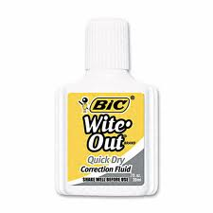
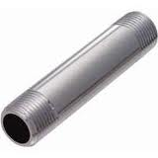
Changes to the OSHA HAZCOM Standard
LABEL: Other Pictograms You May See
Environment
Acute or Chronic Aquatic Toxicity
Enforced By EPA (Not OSHA)
Biological
Biological Substances Can Be Hazardous But Are Not Regulated by OSHA
Exempt:
Consumer Products
Articles That Under Normal Conditions Pose No Physical Hazard or Health Risk
Can Change If Cut Into or Welded

Slide 25
Changes to the OSHA HAZCOM Standard
SAMPLE
LABEL:
Precautionary Statements
Describes Recommended Measures to Minimize or Prevent Adverse Effects Resulting From Exposure or From Improper Handling or Storage
Standardized Phrases are Pre-Determined by its Chemical Classification and Category
ToxiFlam (Contains: X Y Z)
Danger!
Toxic If Swallowed
Flammable Liquid and Vapor
Do not eat, drink or use tobacco when using this product. Wash hands thoroughly after handling. Keep container tightly closed. Keep away from heat/sparks/open flame – No Smoking. Wear protective gloves and eye/face protection. Ground container and receiving equipment. Use explosion-proof electrical equipment. Take precautionary measures against static discharge. Use only non-sparking tools. Store in cool/well ventilated place.
IF SWALLOWED: Immediately call a POISON CONTROL CENTER or doctor/physician. Rinse mouth.
In case of fire, use water fog, dry chemical, CO₂ or “alcohol” foam.
See Safety Data Sheet for further details regarding this product.
MyCompany, MyStreet, MyTown NJ 00000
Tel: 444 999 9999

Slide 26
Changes to the OSHA HAZCOM Standard
SAMPLE
LABEL:
Supplier Identification
The Name
Address and
Telephone Number
Of the
Chemical Manufacturer
Importer or
Other Responsible Party
ToxiFlam (Contains: X Y Z)
Danger!
Toxic If Swallowed
Flammable Liquid and Vapor
Do not eat, drink or use tobacco when using this product. Wash hands thoroughly after handling. Keep container tightly closed. Keep away from heat/sparks/open flame – No Smoking. Wear protective gloves and eye/face protection. Ground container and receiving equipment. Use explosion-proof electrical equipment. Take precautionary measures against static discharge. Use only non-sparking tools. Store in cool/well ventilated place.
IF SWALLOWED: Immediately call a POISON CONTROL CENTER or doctor/physician. Rinse mouth.
In case of fire, use water fog, dry chemical, CO₂ or “alcohol” foam.
See Safety Data Sheet for further details regarding this product.
MyCompany, MyStreet, MyTown NJ 00000
Tel: 444 999 9999

Slide 27
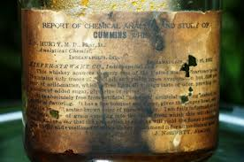
the OSHA HAZCOM Standard
LABELs:
Do Not Open / Use
the Container If:
No Label
Torn or Partially Missing Label
Label You Cannot Read
Report to Supervisor
or BCB Safety for Replacement or Disposal

Slide 28
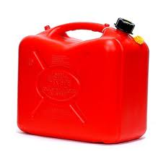
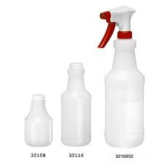
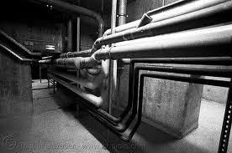
the OSHA HAZCOM Standard
LABELs Not Required On:
Portable Containers -
When Transferred For Personal Use (by that Employee) ONLY
Must Be Used by End of Shift
Must Have Label If Passed On to Another Worker
Piping Systems

Slide 29
Safety Policies & Programs
OSHA’s Revised HAZCOM Standard
New Labels with Added Information
Signal Word
Hazard Statement
Pictograms
Precautionary Statement
New Safety Data Sheet Format with 16 Prescribed Parts
How to Find SDS on SiteHawk: BCB’s On-Line Inventory
QUESTIONS???
Contact BCB Safety: Holly Bockow, 737-2311 / Bernie Lee, 737-2315

